Slide 1
Psychosis classification using diffusion MRI
and cognitive-behavioral data
Yu Veronica Sui

Slide 2
datasets
Diffusion MRI data
Mean diffusion kurtosis, whole brain coverage
Extreme values due to imperfections in MRI scan and errors in diffusion model fitting
Treating every brain region as a variable, hence a LOT of variables (more than number of observations)
Cognitive test data
24 tests in total
IQ, recall and recognition, symbol coding
…
Some missing values
5 participants didn’t have cognitive tests scores

Slide 3
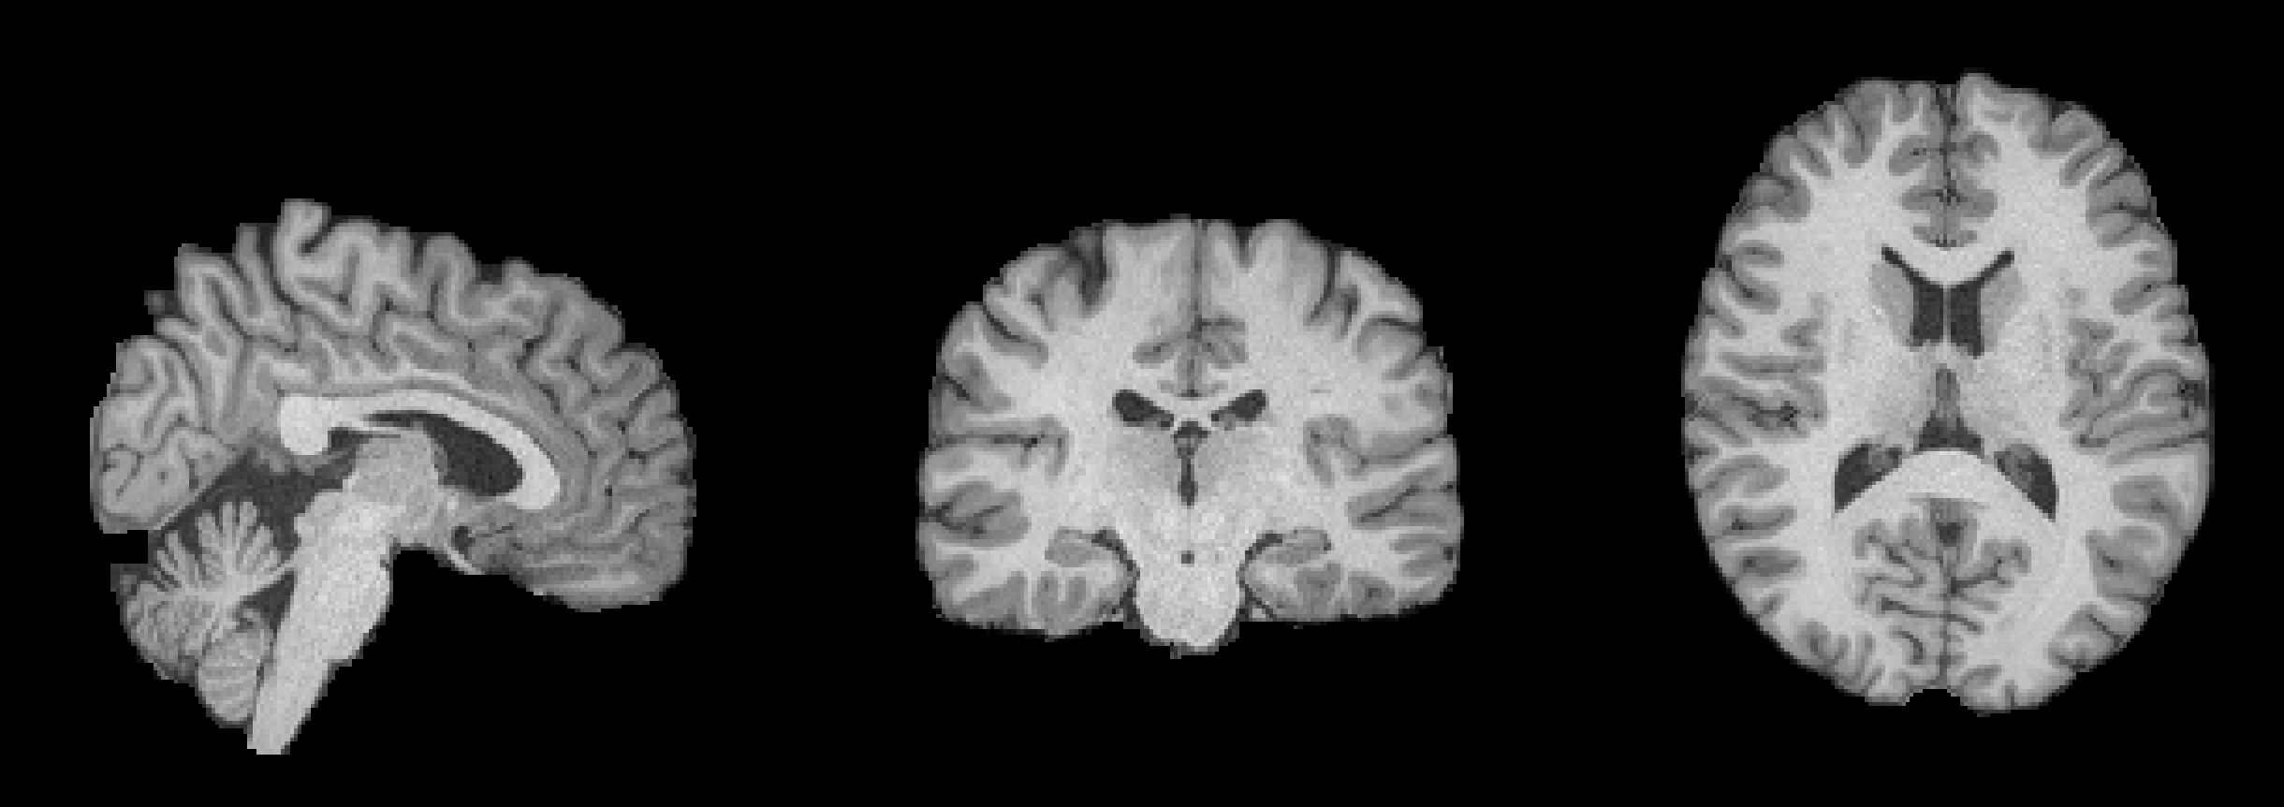
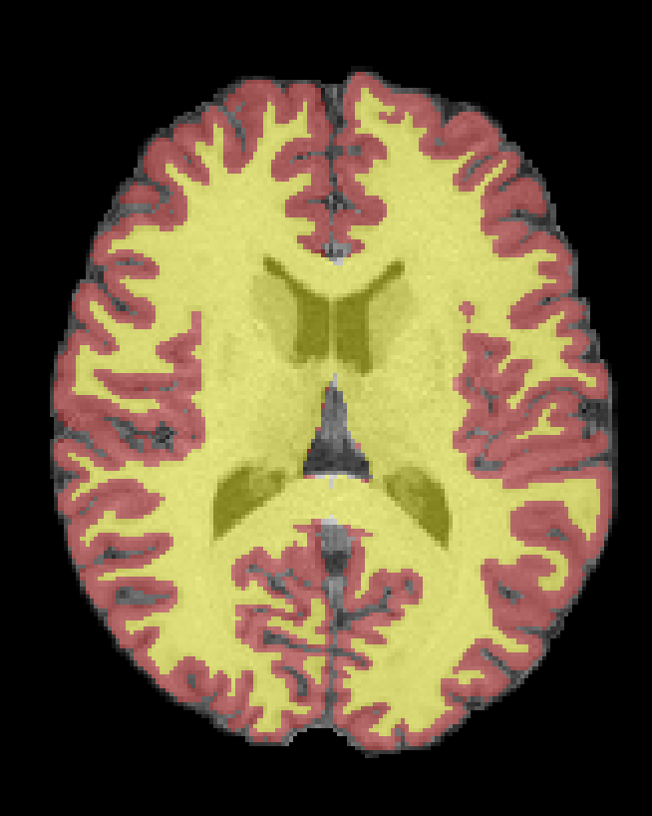
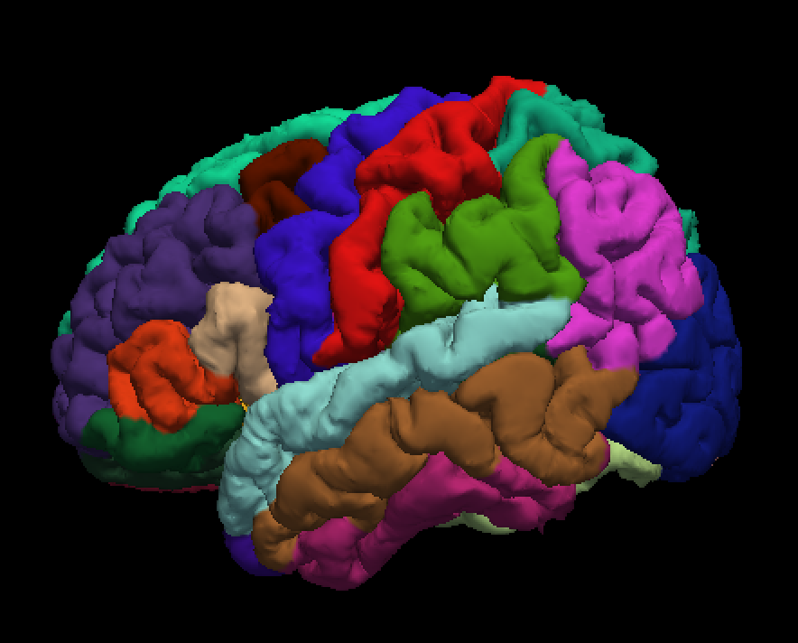
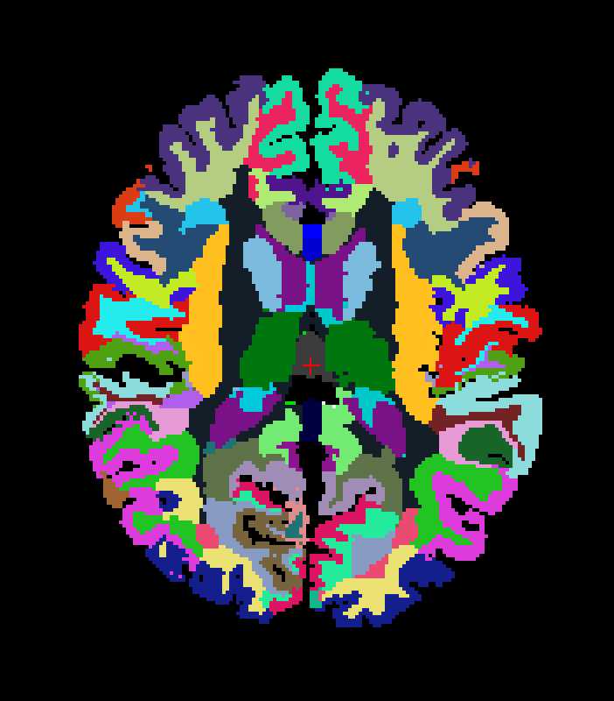


On both left and right sides
- 34 grey matter regions
- 34 white matter regions
- 7 subcortical structures
Corpus callosum

Slide 4
MRI data Cleaning
Mean MK
Missing & extreme values
Eliminate regions that didn’t have great coverage in MRI scan.
Cleaned out regions that had outliers basing on theoretical limitations (e.g., mean diffusion kurtosis values shouldn’t be smaller than 0 or larger than 2).
regions

Slide 5
MRI data Cleaning
Mean MK
Missing & extreme values
Eliminate regions that didn’t have great coverage in MRI scan.
Cleaned out regions that had outliers basing on theoretical limitations (e.g., mean diffusion kurtosis values shouldn’t be smaller than 0 or larger than 2).
regions
Mean MK
regions

Slide 6
Left and right hemisphere separated
Left and right hemisphere together
regions
regions
regions

Slide 7
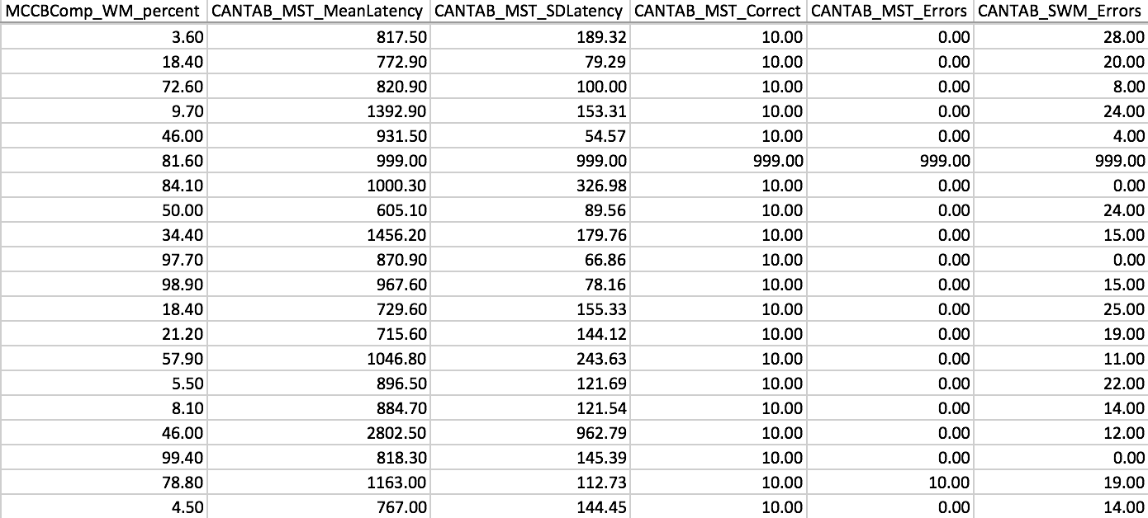
Cognitive data Cleaning
Eliminate observations with many missing scores
Probably didn’t complete the whole test
Eliminate scores that have very low variance

Slide 8
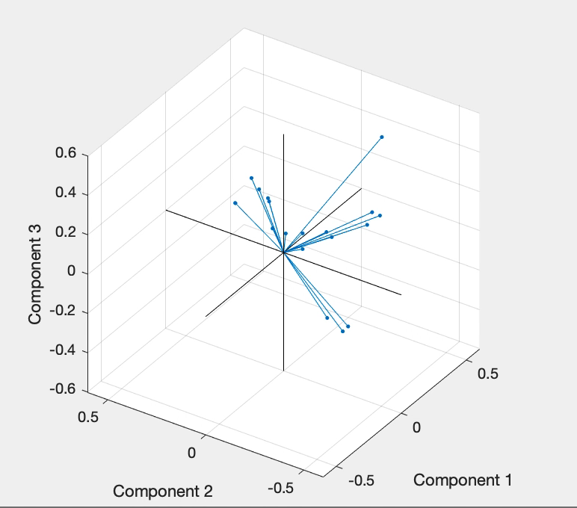
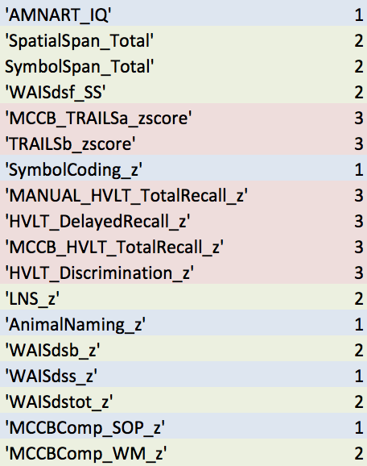
Cognitive dataset PCA
PCA
18 test scores remaining
Using alternating least squares algorithms to deal with missing values (14 missing)
Found 3 principle components explaining 71.7% of the total variance

Slide 9
Group differences
Controls
Patients
*
*

